Slide 1
RSM222
Management Accounting 1
Class 11: Capital Budgeting Decisions
Elisa Zuliani

Slide 2
Learning Objectives
Evaluate the acceptability of an investment project using the net present value method.
Evaluate the acceptability of an investment project using the internal rate of return method.
Evaluate an investment project that has uncertain cash flows.
Rank investment projects in order of preference.
Determine the payback period for an investment.
Calculate simple rate of return for an investment simple rate of return for an investment.

Slide 3
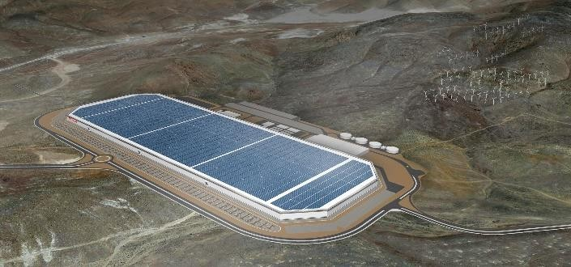

What are Capital Investments?
Capital investments are long-term investments in which the assets involved
have useful lives of multiple years.
  Purchase plant assets.
  Develop new product lines.
  Acquire subsidiary companies.
Capital Investments commit financial resources for large periods of time and are difficult, if not impossible, to reverse once the funds are invested.
Companies stand to benefit from good capital investments (or suffer from poor
ones) for many years.

Slide 4
What is Capital Budgeting?
Capital budgeting refers to the process of evaluating and prioritizing capital investment opportunities.
How is this Management Accounting?
Relies heavily on estimates of future operating results.
Estimates often involve a considerable degree of uncertainty.
There are many nonfinancial factors.
How is this different from last week?
Underlying Question: How do we best use limited firm resources to maximize firm
value.

Slide 5


Budgets versus Capital Budgets
Budgeting: Projection of the performance of the firm based on the anticipated performance for the upcoming year.
Capital Budget: Process of planning significant outlays on projects that have long- term implications.

Slide 6
Process for Capital Budgeting
When resources are limited, capital budgeting procedures are needed.
Determine capital needs for both new and existing projects.
Identify and establish resource limitations.
Establish baseline criteria for alternatives.
Evaluate alternatives using screening and preference decisions.
Make the decision.
Does a proposed project meet some preset standard of acceptance?
How do you select from among several different projects?
Why distinguish?

Slide 7
Capital Budgeting Decision Tools
To determine the desirability of investment proposals, there are several analytical tools:
Net Present Value (NPV)
Internal Rate of Return (IRR)
Project Profitability Index (PI)
Payback Period
Simple Rate of Return
All Fair Game on the Exam…
To evaluate alternatives, businesses will use different tools to compare outcomes. The outcomes will not only be compared against other alternatives, but also against a predetermined rate of return on the investment (or minimum expectation) established for each project consideration.

Slide 8
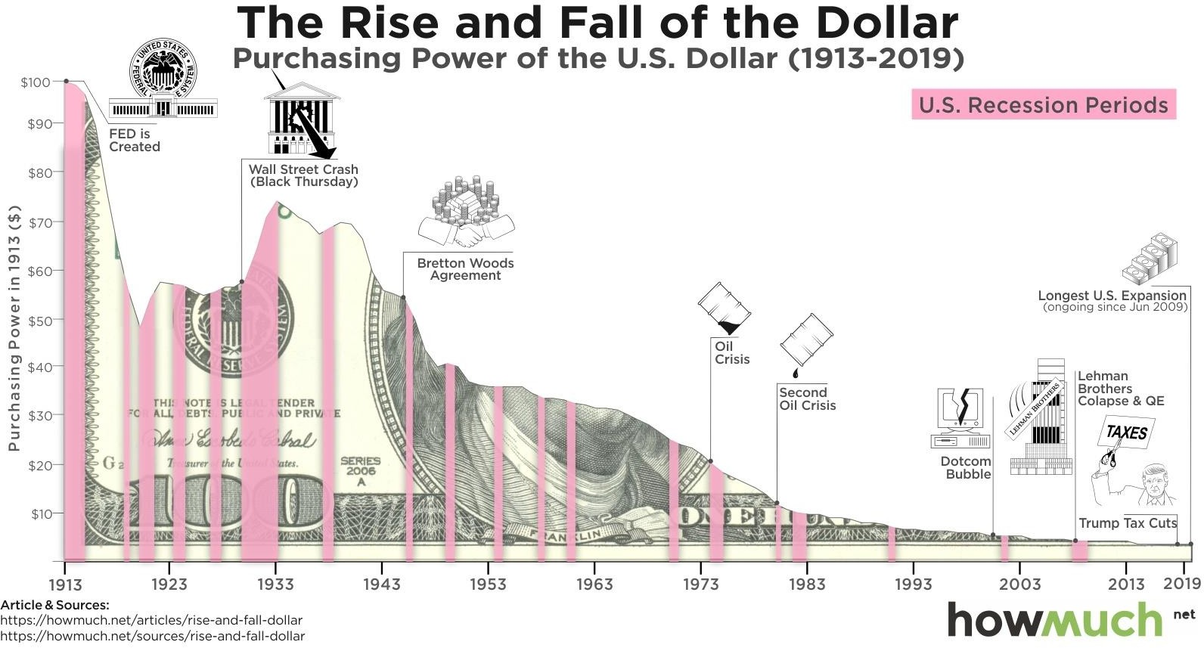
Time Value of Money
A dollar today is worth more than a dollar a year from now.
Underlying Assumption:
A dollar today is worth more than a dollar received in the future.

Slide 9
Time Value of Money
A dollar today is worth more than a dollar a year from now
Investments that promise earlier returns are preferable to those that promise later returns
Involve discounted cash flows

Slide 10
Typical Capital Budgeting Decisions
Cost reduction decisions
Expansion decisions
Equipment selection
Lease versus buy
Equipment replacement

Slide 11
Net Present Value (NPV)

Slide 12
Net Present Value (NPV)
The net present value (NPV) is the difference between the present value of cash inflows and the cash outflows.
  NPV estimates the amount of wealth that the project creates.
  Cash flows are either positive (cash received) or negative (cash paid)
Decision Criteria:
Investment projects should be:
Accepted if NPV > 0
Rejected if NPV < 0
PV Cash inflow of project
PV Cash outflow of project
-
Net Present Value means that the rate of return on the capital investment is greater (less) than the discount rate used in the analysis

Slide 13
PV Formulas
Have these on your Cheat Sheet! I will not provide annuity tables.
NPV Assumptions:
Present Value of Future Cash Flow
The cash generated by a project is immediately reinvested to generate a return at a rate that is equal to the discount rate used in present value analysis.
The inflow and outflow of cash other than initial investment occur at the end of each period.
𝑃𝑉 = 𝐹𝑉 ∗ (1 + 𝑖)^{−𝑡}
Present Value of an Ordinary Annuity
1 − 1 + 𝑖
−𝑡
𝑃𝑉 = 𝐹𝑉 ∗
𝑖

Slide 14
What is an Appropriate Discount Rate?
Choosing the proper discount rate is important for an accurate Net Present Value analysis.
  Use the minimum rate of return acceptable for the company
    Cost of capital to finance the capital expenditure
    Cost of using the company’s internal funds
    Rate of return needed to attract outside investment for the capital project
    Rate of return the company can receive from an alternative investment
    Threshold Rate of Return (TRR) required by the company
    WACC
On the exam, we will provide the discount rate

Slide 15
Net Present Value Method
To determine net present value . . .
  Calculate the present value of cash inflows
  Calculate the present value of cash outflows
  Subtract the present value of the outflows from the present value of the inflows

Slide 16
Net Present Value Metod

Slide 17
Typical Cash Outflows
Repairs and
maintenance
Working
capital
Outflows
Initial
investment
Incremental
operating
costs

Slide 18
Typical Cash Inflows
Salvage
value
Release of
working
capital
Reduction
of costs
Inflows
Incremental
revenues

Slide 19
Let’s apply …
Carver Dental Clinic is considering the purchase of an attachment for its X-ray machine.
No investments are to be made unless they have an annual return of at least 1
Will Carver Dental Clinic invest in the attachment?

Slide 20
Let’s apply…
Present value
of an annuity
of $1 table

Slide 21
Let’s apply …
The cash inflows are sufficient to recover the $3,170 initial investment and to provide exactly a 10% return on the investment. The investment should be made. (Annual depreciation is not relevant for this analysis.)

Slide 22
Two Simplifying Assumptions
Two simplifying assumptions are usually made in net present value analysis:
All cash flows other than the initial investment occur at the end of periods.
All cash flows generated by an investment project are immediately reinvested at a rate of return equal to the discount rate.

Slide 23
Let’s apply….
Lester Company has been offered a five-year contract to provide component parts for a large manufacturer. At the end of five years the working capital will be released and it may be used elsewhere by Lester Company. Lester Company uses a discount rate of 10%.
Should the contract be accepted??

Slide 24
Let’s apply….
Annual net cash inflow from operations:

Slide 25
Let’s apply….
Present value of an annuity of $1
factor for 5 years at 10%.

Slide 26
Let’s apply….
Present value of $1 factor for year 3 at 10%

Slide 27
Let’s apply….
Present value of $1 factor for year 3 at 10%

Slide 28
Let’s apply….
Present value of $1
factor for year 5 at 10%.

Slide 29
Let’s apply…
Accept the contract because the project has a positive net present value.
This means that contract provides more than a 10% return.

Slide 30
Constraints
Companies can’t do ever
Ideally, businesses would pursue any and all projects and opportunities that enhance value.
  The amount of capital or money any business has available for new projects is limited; management uses capital budgeting techniques to determine which projects will yield the best return over an applicable period.
  Firms must compare projects to decide on the best project
Time Considerations | Money Considerations
Employee commitments | Lack of liquidity
Project set-up | Tied up in non-liquid assets
Time-frame necessary to secure financing | Up-front acquisition costs
16

Slide 31
Let’s apply ….
Denny Associates has been offered a four-year contract to supply the computing requirements for a local bank.
The working capital would be released at the end of the contract.
Denny Associates requires a 14% return.
Calculate the Net Present value of the contract with the bank.

Slide 32
Let’s apply…
What is the net present value of the contract with the local bank?

Slide 33
Preference Decisions
To compare competing investment projects, the following net present value approaches can be used:
  Total-cost
  Incremental cost

Slide 34
Preference Decisions – Total-cost Approach
White Company has two alternatives:
  1. remodel an old car wash or,
  2. remove it and install a new one.
The company uses a discount rate of 10%.

Slide 35
Preference Decisions – Total-cost Approach- Replace
Calculate the present value if White installs a new washer:

Slide 36
Preference Decisions – Total-cost Approach – Replace Option
If the new washer is installed, the investment is expected to yield a positive net present value of $83,202

Slide 37
Preference Decisions – Total-cost Approach- Remodel Option
Calculate the present value if White remodels the existing washer:

Slide 38
Preference Decisions – Total-cost Approach
Both projects yield a positive net present value. However, investing in a new wash will produce a higher net present value than remodeling the old washer

Slide 39
Preference Decisions – Incremental-cost Approach
Under the incremental-cost approach, only the cash flows that differ between alternatives are considered.
Apply the incremental cost approach to the White Company decision.

Slide 40
Preference Decisions – Incremental-cost Approach
The same answer is determined under both the total cost and the incremental-cost approach

Slide 41
Preference Decisions – Least cost approach
In decisions where revenues are not directly involved, managers should choose the alternative that has the least total cost from a present value perspective.

Slide 42
Preference Decisions – Least cost approach… Let’s apply
Home Furniture Company is trying to decide whether to overhaul an old delivery truck or to purchase a new one.
The company uses a discount rate of 10%.e company uses a discount rate of 10%.

Slide 43
Preference Decisions – Least cost approach… Let’s apply
This is the cheaper option

Slide 44
Internal Rate of Return (IRR)

Slide 45
Internal Rate of Return
The internal rate of return is the rate of return promised by an investment project over its useful life.
It is computed by finding the discount rate that will cause the net present value of a project to be zero.
It works very well if a project’s cash flows are identical every year. If the annual cash flows are not identical, a trial-and-error process must be used to find the internal rate of return.

Slide 46
Internal Rate of Return
The IRR is that discount rate that forces the NPV to zero.
Decision Criteria:
𝑃𝑉 = 𝐹𝑉 ∗ (1 + 𝑖)^{−𝑡}
Investment projects should be:
Accepted if IRR > Hurdle Rate
Rejected if IRR < Hurdle Rate
Isolate for the Rate
Project with the highest IRR should be selected. The higher the internal rate of return,
the more desirable the project.

Slide 47
NPV versus IRR
NPV is superior to IRR
  IRR assumes that any cash flows can be reinvested at rate of return equal
to IRR
  NPV assumes that any cash flows can be reinvested at the discount rate
Which is more realistic?
BUT: The net present value of one project cannot be directly compared to the net present value of another project unless the investments are equal.
  Relative vs. Absolute Measures…

Slide 48
Internal Rate of Return
General decision rule . . .

Slide 49
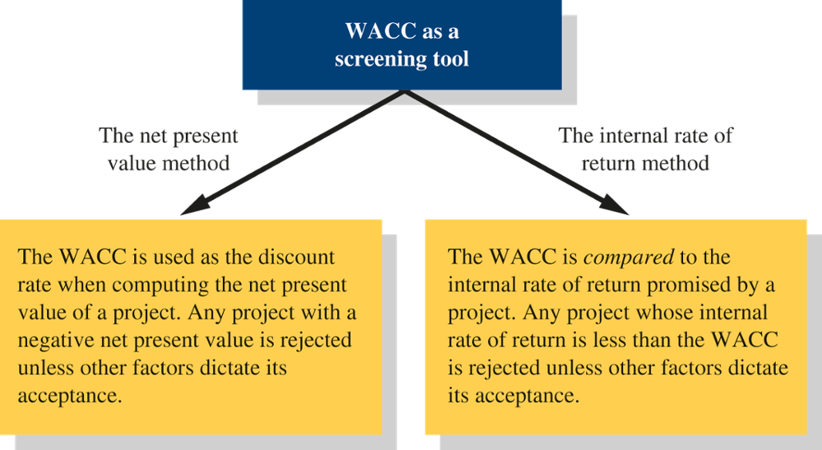
Weighted-Average Cost of Capital (WACC)

Slide 50
Net Present Value versus Internal Rate of Return
NPV offers a key advantage over the IRR method because of the assumption each method makes about the reinvestment of cash flows.
The NPV method makes a more realistic assumption about the rate of return that can be earned on cash flows from the project.
When the NPV method and IRR method do not agree concerning the attractiveness of a project, it is best to go with the NPV method.

Slide 51
Let’s apply …
The company is considering replacing an old delivery car. The new car cost $20,000. The company expects it will save $5,500 per year in maintenance and fuel costs for 5 years. At the end of year 5, the car can be sold for $3,000. The company uses 10% discount rate
Calculate the IRR for this car replacement

Slide 52
Let’s apply …
Year | PV factor 10% | PV factor 15%
1 | .9091 | .8696
2 | .8264 | .7561
3 | .7513 | .6575
4 | .6830 | .5718
5 | .6209 | .4972

Slide 53
Let’s apply…
Compute the NPV of the Car @ 10%

Slide 54
Let’s apply…
Need to pick a discount rate that will give a negative NPV – what about 15%
Compute the NPV of the Car @ 15%

Slide 55
Let’s apply …
Interpolate IRR
IRR = 10% + $2,712 x (15% - 10%)
$2,712 –(-$71)
IRR = 10% + 4.87% = 14.9%

Slide 56
Project Profitability Index

Slide 57


Project Profitability Index
Is a measure of a project or investment attractiveness.
  Profitability Index >1: Approve Project
  Profitability Index <1: Reject Project
Profitability index depicts a “relative” measure whereas NPV represents an “absolute” measure of value.
Select project with highest PPI
PV of Net Cash Inflows
Investment required
“The discounted cash inflow per
dollar of discounted cash outflow”

Slide 58
Ranking Investment Projects
Profitability Present value of net cash inflows
index Investment required
=
Investment A Investment B
Present value of net cash inflows $81,000 $6,000
Investment required 80,000 5,000
Profitability index 1.01 1.20
The higher the profitability index, the
more desirable the project.

Slide 59
Payback Period

Slide 60
Payback Method
The payback period is the length of time that it takes for a project to recover its initial cost from the cash receipts that it generates.
When the net annual cash inflow is the same each year, this formula can be used to compute the payback period:
Investment required
Net annual cash inflow
Payback period =

Slide 61
Payback Method… Let’s apply
Management at The Daily Grind Café wants to install a new espress bar.
The espresso bar:
        costs $140,000 and has a 10-year life.
        will generate net annual cash inflows of $35,000.
Management requires a payback period of 5 years or less on all investments.
What is the payback period for the espresso bar?

Slide 62
Payback Period
Length of time to recover project initial cost.
Lower payback period means investment will be repaid faster.
  Quicker an investment’s cost is recovered, the sooner the funds may be put to other use.
  Reduces the risk that changes in economic conditions will prevent full recovery of an investment.
Investment required
Net annual cash inflow
BUT Payback Period ignores:
  Total profitability and cash flows over the entire
life of an investment
  Ignores the timing of the future cash flows.

Slide 63
Payback Method… Let’s apply
Investment required__
Net annual cash inflow
Payback period =
$140,000
$35,000
Payback period =
Payback period =
4.0 years
According to the company’s policy, management would invest in the espresso bar because its payback period is less than 5 years.

Slide 64
Payback Method… Shortcoming
Consider two projects, each with a five-year life and each costing $6,000.
 |  | Project One | Project Two
 |  | Net Cash | Net Cash
Year |  | Inflows | Inflows
1 |  | $ 2,000 | $ 1,000
2 |  | 2,000 | 1,000
3 |  | 2,000 | 1,000
4 |  | 2,000 | 1,000
5 |  | 2,000 | 1,000,000
Is Project One better because it has a shorter payback period?
Notes:
This method ignores the cash flow after the payback perod

Slide 65
Simple Rate of Return

Slide 66
Simple Rate of Return
Does not focus on cash flows – rather it focuses on accounting net operating income.
The following formula is used to calculate the simple rate of return:
Incremental Incremental expenses,
revenues including depreciation
–
Simple rate
of return
=
Initial investment *
*Should be reduced by any salvage from the sale of old equipment at the beginning of the project

Slide 67
Simple Rate of Return… Let’s apply
Management at The Daily Grind Café wants to install a new espress bar.
The espresso bar:
        costs $140,000 and has a 10-year life.
        will generate incremental revenues of $100,000 and incremental expenses of $65,000 including depreciation
        What is the simple rate of return on the investment project?

Slide 68
Simple Rate of Return… Let’s apply
Simple rate
of return
$35,000
$140,000
=
= 25%

Slide 69


IN CLASS EXAMPLE
Mountain Adventures Company

Slide 70
Any Questions?

